Slide 1
Scratch
scratch.mit.edu

Slide 2
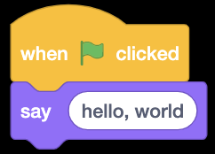

Slide 3
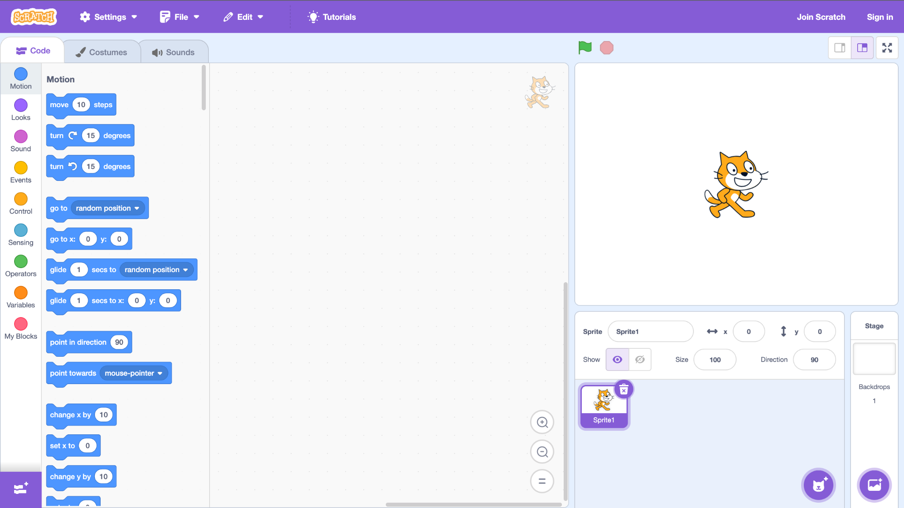

Slide 8
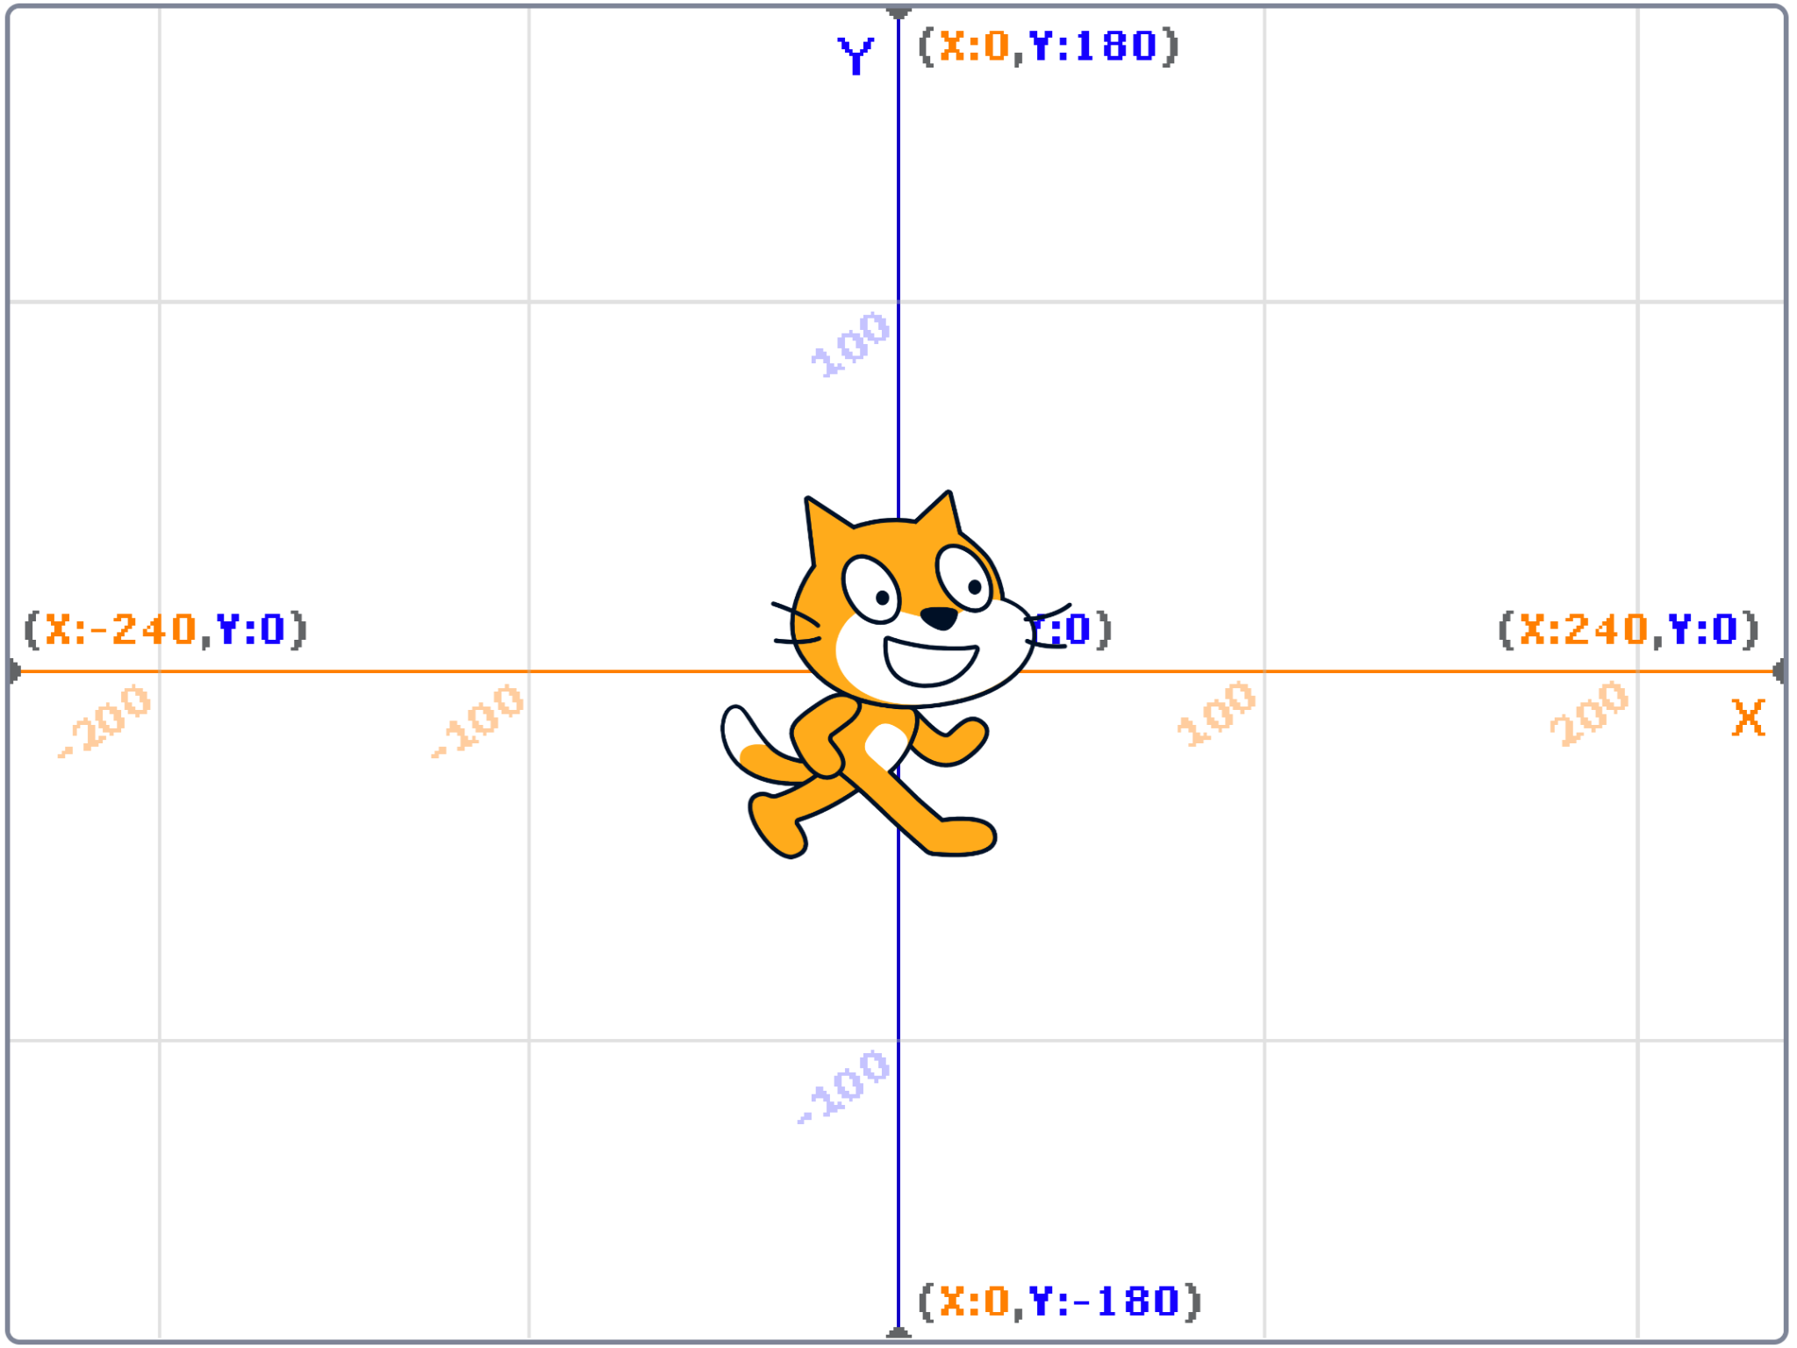

Slide 9
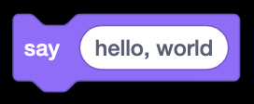

Slide 10
algorithm
input →
→ output

Slide 11

algorithm
→
→
→ output

Slide 12

→
→
→ output

Slide 13
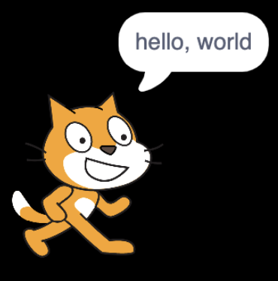
→
→

Slide 14
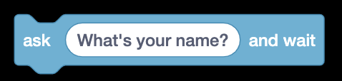

Slide 15
algorithm
input →
→ output

Slide 16

algorithm
→
→
→ output

Slide 17
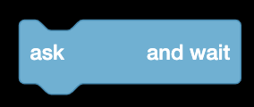
→
→
→ output

Slide 18

→
→

Slide 19
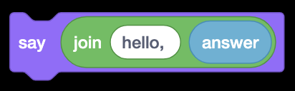

Slide 20
algorithm
input →
→ output

Slide 21

algorithm
→
→
→ output

Slide 22

→
→
→ output

Slide 23

→
→

Slide 24
→

Slide 25
→

Slide 26
→
→

Slide 27





